Slide 1

AWS
INTRODUCTION TO MACHINE LEARNING

Slide 2
REVIEW OF LINEAR ALGEBRA FOR MACHINE LEARNING
Basics :
Scalars: Single values, denoted as lowercase letters (e.g., aaa).
Vectors: Ordered lists of numbers denoted as bold lowercase (e.g., v\mathbf{v}v).
Matrices: 2D arrays of numbers denoted as bold uppercase (e.g., A\mathbf{A}A).
Tensors: Generalizations of matrices to higher dimensions (common in deep learning).
2. Key Operations :
Addition/Subtraction: Element-wise for same-sized matrices or vectors.
Scalar Multiplication: Each element is multiplied by a scalar.
Dot Product: Multiplication of two vectors to yield a scalar (measures similarity).
Matrix Multiplication: Combines two matrices; central for transformations (applying weights).

Slide 3
INTRODUCTION AND MOTIVATION FOR MACHINE LEARNING
Machine learning is a subset of artificial intelligence that involves using algorithms and statistical models to enable computers to perform tasks without being explicitly programmed. ML allows systems to learn from data and improve their performance over time based on experience.
Types of Machine Learning:
Supervised Learning: The model is trained on labeled data, the input data includes input features and the correct output.
Unsupervised Learning: The model works with unlabeled data, has input data with no defined output
Semi-supervised Learning: A mix of labeled and unlabeled data is used, often when labeled data is scarce.
Reinforcement Learning: This approach involves an agent that learns by interacting with its environment, making decisions, and receiving feedback in the form of rewards or penalties.

Slide 4
EXAMPLES
Image Recognition and Computer Vision
Facial Recognition: Used in social media, surveillance, and smartphone security, facial recognition systems can identify or verify people based on their facial features
Object Detection: Self-driving cars rely on computer vision to detect and classify objects like other cars, pedestrians, and traffic signals, ensuring safe navigation.
Medical Imaging: AI models help radiologists detect abnormalities (like tumors) in X-rays, MRIs, and CT scans, aiding early diagnosis and treatment planning.
Augmented Reality (AR): Image recognition algorithms track real-world objects, which AR applications then overlay with virtual content for gaming, shopping, or remote assistance.

Slide 5
EXAMPLES
2. Natural Language Processing (NLP)
Language Translation: Apps like Google Translate use NLP models to translate text or speech in real-time, supporting multiple languages.
Sentiment Analysis: Businesses use NLP to analyze customer sentiment in reviews or social media, helping them understand consumer opinions.
Chatbots and Virtual Assistants: Siri, Alexa, and other voice-activated assistants use NLP to understand spoken language, answer questions, and perform tasks.
Content Generation and Summarization: Tools like GPT can generate human-like text, summarize articles, or assist with creative writing, enhancing productivity.

Slide 6
VC DIMENSION
VC Dimension :
(Vapnik-Chervonenkis Dimension): The VC dimension is a measure of a model’s capacity, or its ability to classify a variety of data patterns. It’s defined as the maximum number of points a model can shatter, meaning the model can perfectly classify all possible labelings of those points. Higher VC dimensions imply more complex models, potentially leading to overfitting, while lower VC dimensions suggest simpler models that may underfit. It’s crucial for understanding a model’s generalization ability.

Slide 7
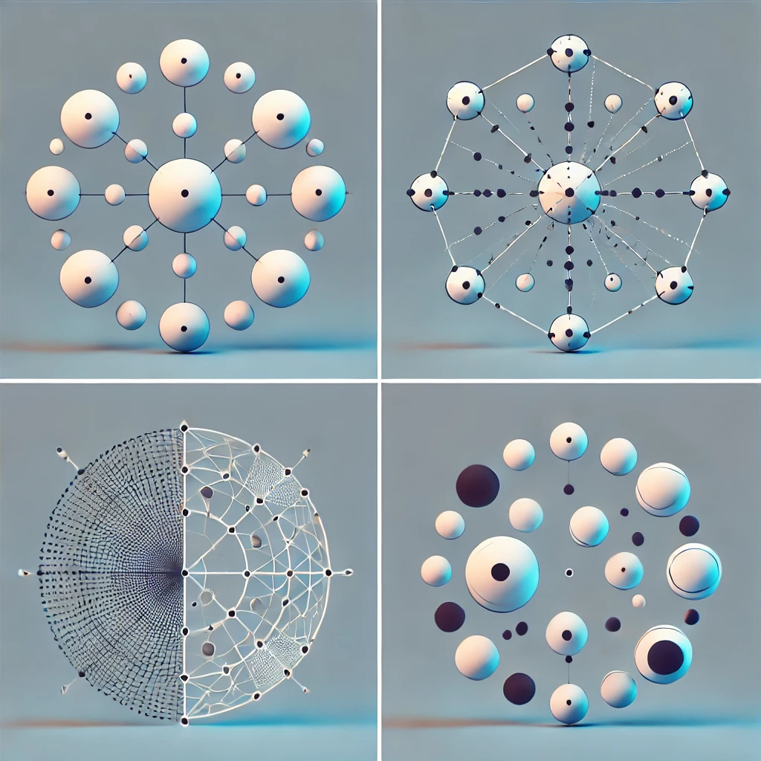
Show a visual of points being classified by different shapes (e.g., line, circle) to represent the idea of shattering.

Slide 8
PROBABLY APPROXIMATELY CORRECT (PAC) LEARNING
Probably Approximately Correct (PAC) Learning is a framework in machine learning that quantifies a model's ability to learn from data. In PAC learning, a model is considered successful if, with high probability (the "Probably" part), it can learn a hypothesis that is approximately correct—that is, close enough to the true function or distribution generating the data.
Key points:
Probably: The model will produce an accurate hypothesis with a high probability (e.g., 95%).
Approximately Correct: The hypothesis may not be perfect, but its error is within an acceptable margin (ε).
Efficiency: PAC learning also considers the computational efficiency of finding this hypothesis within a reasonable amount of data and time.

Slide 9
PROBABLY APPROXIMATELY CORRECT (PAC) LEARNING
Example
Suppose we want a spam classifier that is PAC-learnable with parameters ϵ=0.05\epsilon = 0.05ϵ=0.05 and δ=0.01\delta = 0.01δ=0.01. In this case:
"Approximately Correct": We are willing to accept up to a 5% error rate (ϵ=0.05\epsilon = 0.05ϵ=0.05) on unseen data.
"Probably": We want to be 99% confident (1−δ=0.991 - \delta = 0.991−δ=0.99) that the classifier’s error rate will not exceed 5% on new emails.
The PAC framework tells us how many samples and what computational resources would be required to achieve this confidence and accuracy, making it a practical guide for designing and evaluating machine learning models.

Slide 10
HYPOTHESIS SPACE
The hypothesis space in machine learning is the set of all possible models or functions that a learning algorithm can choose from to fit a given dataset. It includes every potential hypothesis (or function) that could map inputs to outputs based on the training data.
Why It’s Essential
Defines Learning Scope: The hypothesis space determines the complexity and flexibility of the models, influencing what patterns or relationships the model can learn from the data.
Affects Generalization: A too-large hypothesis space can lead to overfitting, where the model learns noise instead of patterns. A too-small hypothesis space may underfit, missing important data relationships.
Guides Model Selection: Choosing an appropriate hypothesis space helps balance model accuracy with computational efficiency and generalization ability on new data.

Slide 11
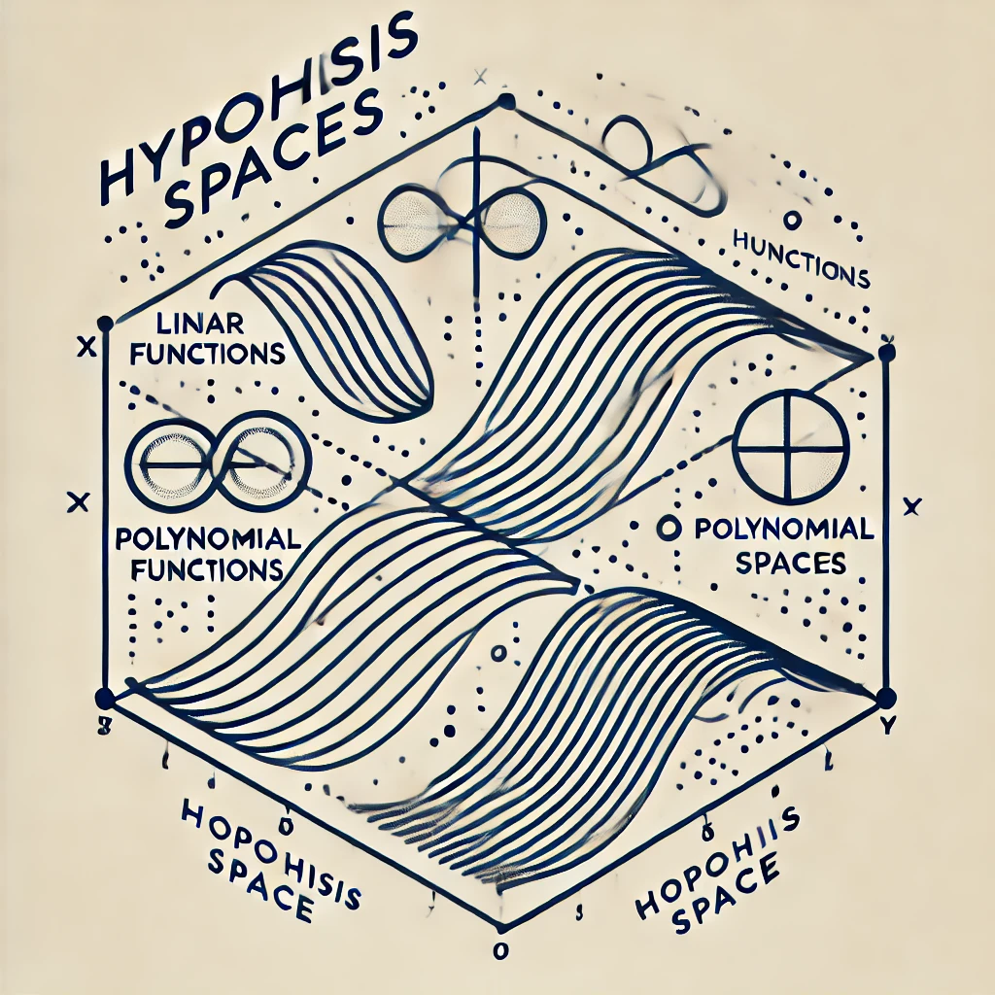
HYPOTHESIS SPACE

Slide 12
INDUCTIVE BIAS
Inductive bias is the set of assumptions a machine learning model makes to predict outputs for unseen inputs based on its training data. It provides the model with a "preference" toward certain solutions, which helps it generalize effectively from limited data.
Purpose:
Generalization: Inductive bias enables a model to go beyond the training data, predicting patterns it hasn't explicitly seen.
Guiding Hypothesis Selection: By narrowing down the hypothesis space, inductive bias helps the model focus on likely solutions rather than exploring every possible one.
Types of Inductive Bias:
Language Bias
Search Bias

Slide 13
SIMPLE ANALOGY OF INDUCTIVE BIAS
Analogy: Finding a Friend's House:
Imagine you're trying to find a friend's new house in a city without an exact address, but they give you some hints. They tell you:
Their house is painted blue.
It’s within a few blocks of a coffee shop.
It’s a two-story building.
Without these hints (assumptions or "biases"), you'd have to search every single house in the city, which would be incredibly time-consuming. However, with these hints, you can ignore houses that don’t meet the criteria (e.g., houses painted red, far from coffee shops, or single-story buildings). These assumptions guide your search, narrowing down the possibilities significantly and making it more likely that you'll find the right house quickly.

Slide 14
GENERALIZATION
Generalization refers to a model's ability to make accurate predictions on new, unseen data, based on patterns learned from the training data. It is a key goal, as a model that generalizes well performs well not only on the training data but also on previously unseen test data.
Good generalization means the model can handle new data effectively.
Overfitting occurs when the model is too specific to the training data and performs poorly on new data.
Underfitting occurs when the model is too simple to capture the underlying patterns in the data.
The bias-variance tradeoff affects generalization: models with high bias may underfit, while those with high variance may overfit.
Techniques like regularization help prevent overfitting and improve generalization.

Slide 15
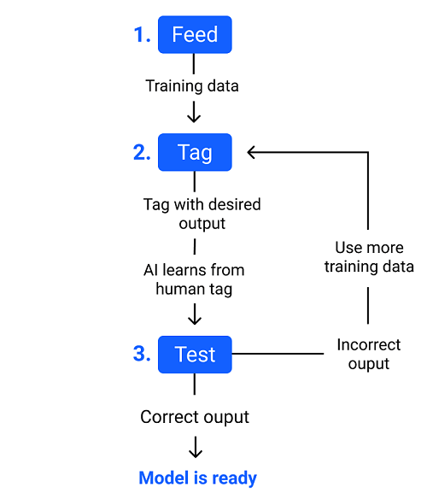
GENERALIZATION OF TRAINING VS. TEST DATA PERFORMANCE

Slide 16
HYPOTHESIS SPACE
The Bias-Variance Trade-Off is a fundamental concept in machine learning that describes the trade-off between two types of errors that affect a model’s ability to generalize:
Bias: The error introduced by overly simplistic assumptions in the model. High bias means the model is too simple, leading to underfitting (poor performance on both training and test data).
Variance: The error introduced by the model’s sensitivity to small fluctuations in the training data. High variance means the model is too complex and overfits, performing well on the training data but poorly on new, unseen data.
Trade-Off:
High bias leads to underfitting.
High variance leads to overfitting.

Slide 17
BIAS-VARIANCE TRADE-OFF VISUALIZATION
Bias-Variance Trade-Off Visualization:
To illustrate the bias-variance trade-off, consider the following:
As model complexity increases (e.g., moving from a linear regression model to a high-degree polynomial), variance increases and bias decreases.
As model complexity decreases, variance decreases and bias increases.
Here’s a simple visualization of how bias and variance interact:
On the x-axis, we have model complexity (from low to high).
On the y-axis, we have the error (which includes both bias and variance).
The total error is a combination of both bias and variance.

Slide 18
BIAS-VARIANCE TRADE-OFF VISUALIZATION
|
Error| /\
| / \
| / \
| / \
| / \
| / \
| / \
| / \
|__/________\________
Low Complexity -> High Complexity
Left side (Low complexity): High bias, low variance — the model underfits.
Right side (High complexity): Low bias, high variance — the model overfits.
Sweet spot: Balanced bias and variance — optimal model performance.

